Slide 1
Introduction to Quantum Computing: From a Layperson to a Programmer in 30 Steps
Hiu-Yung Wong
https://link.springer.com/book/10.1007/978-3-030-98339-0
https://www.amazon.com/Introduction-Quantum-Computing-Layperson-Programmer/dp/3030983382
Playlist: https://www.youtube.com/watch?v=cbCX1QN9UZU&list=PLnK6MrIqGXsJfcBdppW3CKJ858zR8P4eP&index=3

Slide 2
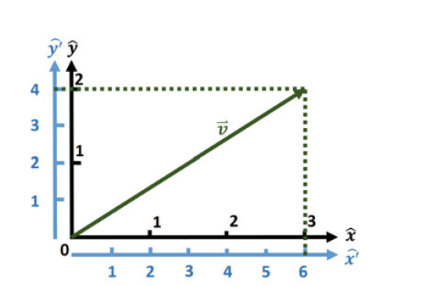



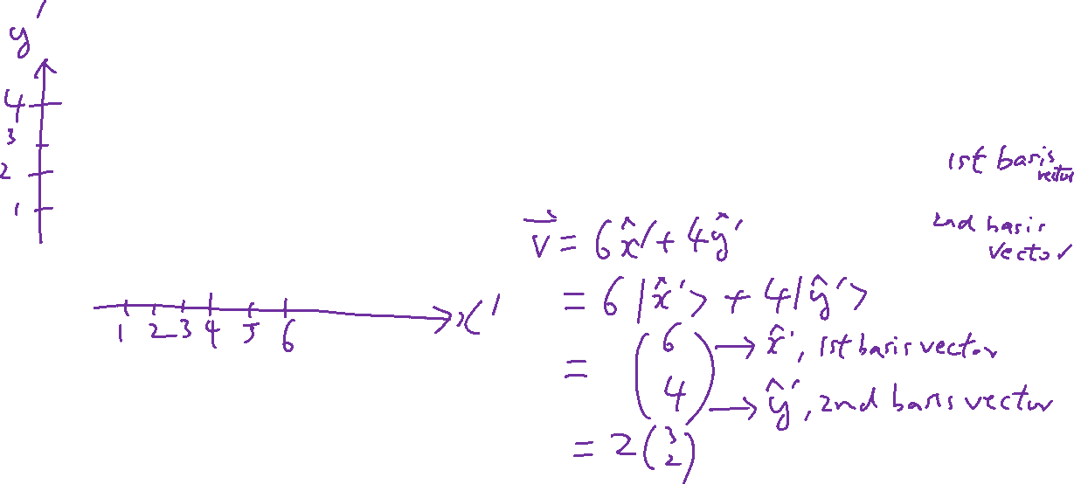
Vector Space and Basis

Slide 3







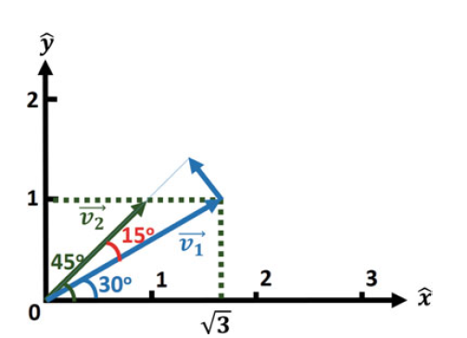

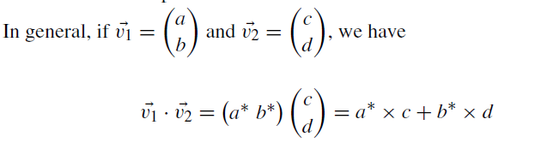
Inner (dot) Product of Vectors

Slide 4


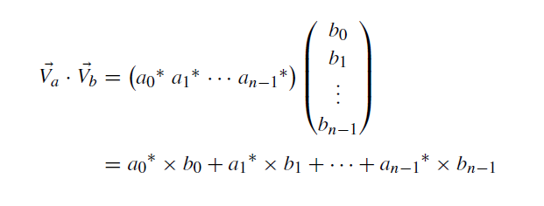
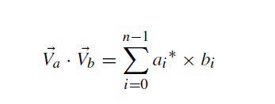
Higher Dimensional Vectors and Complex Coefficients
In an n-D space, any vector, Va, must be a linear combination of the n basis vectors.

Slide 5
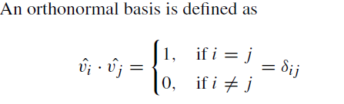

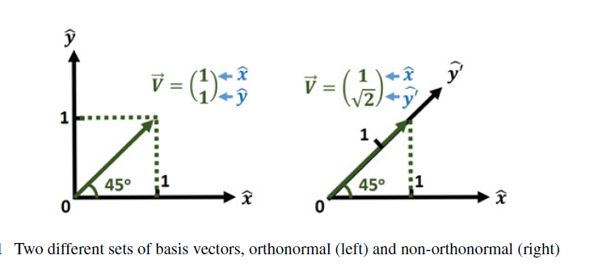


Orthonormal Basis – What we use in Quantum Computing
If the inner product of every basis vector with itself is one (i.e. it is normalized,
If the inner product with other basis vector is zero (i.e. they are orthogonal),

Slide 6



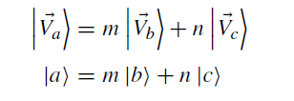
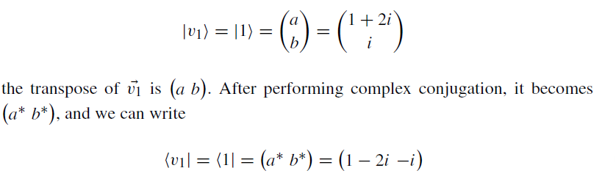
Bra-Ket Notation (Dirac)
The set of vectors in the bra-representation is the same set of vectors in the ket-representation and they form a dual space.

Slide 7

Vector and State and Superposition
Every vector is a state of a physical system

Slide 8
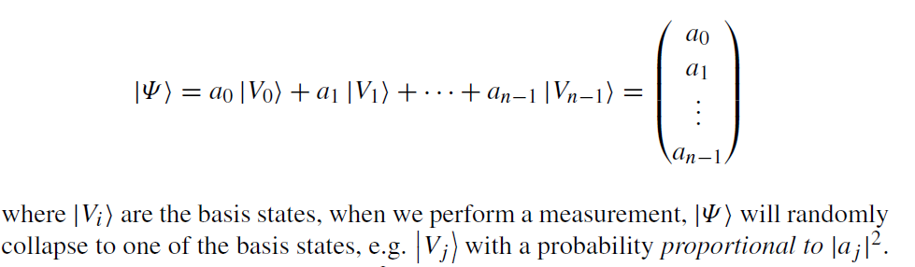
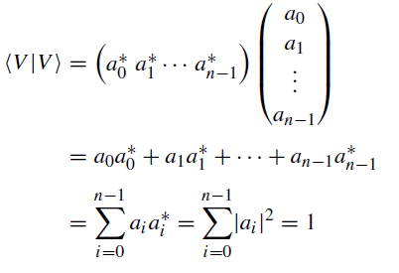
Meaning of Coefficients and Measurement

